Slide 1
Scraping Movie Budgets
Getting Data From the-numbers.com

Slide 2
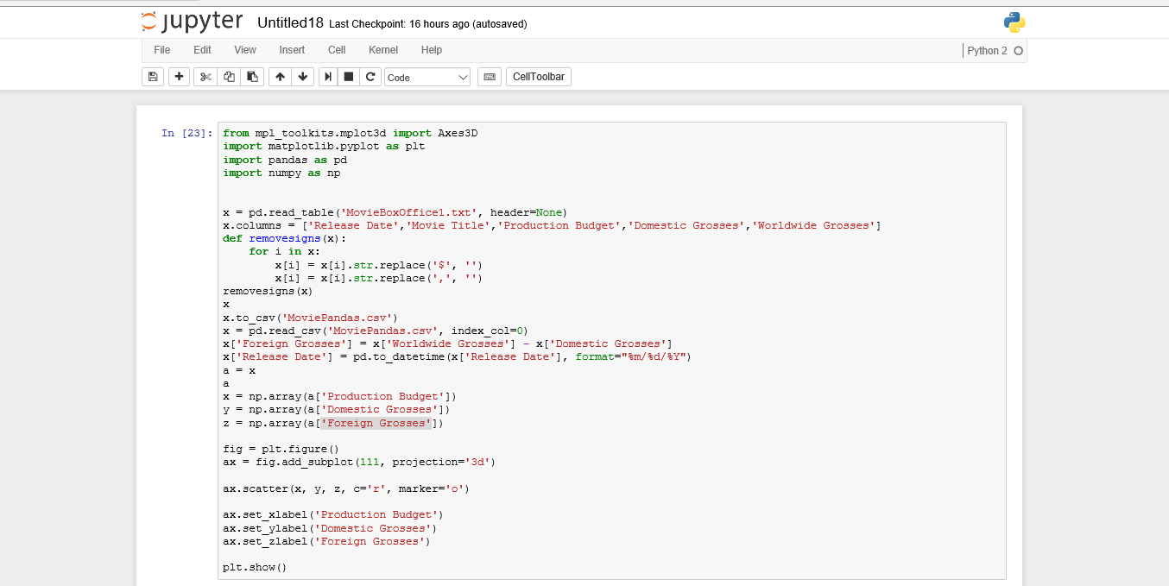
Coding the Scatterplot

Slide 3
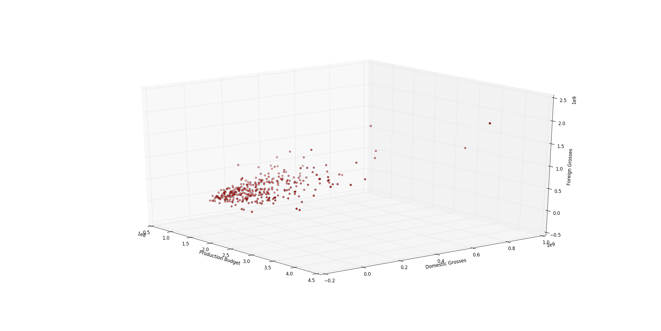
3d Scatterplot

Slide 4
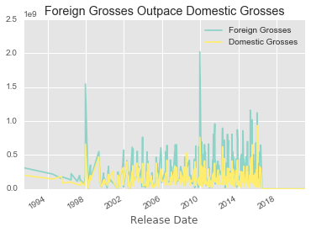

Slide 5
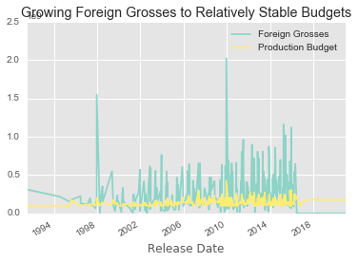

Slide 6
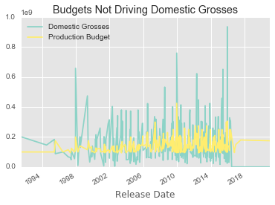

Slide 7
Converting the Release Dates Into Factors
c <- filter(film, film$Month == 'Dec'|film$Month == 'Sep'|film$Month == 'Nov'|film$Month == 'Oct')
c <- mutate(c, Timing = 2)
d <- filter(film, film$Month == 'May'|film$Month == 'Jun'|film$Month == 'Jul')
d <- mutate(d, Timing = 3)
e <- filter(film, film$Month == 'Mar'|film$Month == 'Apr')
e<- mutate(e, Timing = 4)
f <- filter(film, film$Month == 'Aug'|film$Month == 'Jan'|film$Month == 'Feb')
f<- mutate(f, Timing = 1)
film$Timing <- as.factor(film$Timing)
z <- rbind(c,d,e,f)
film <- z

Slide 8
Factor Legend
1 = Dump months
2 = Awards months
3 = Summer
4 = Aggressive

Slide 9
Multiple Linear Regression #1
linear = lm(formula = film$`Foreign Grosses` ~ film$Timing, data = film)

Slide 10
Multiple Linear Regression #1
Call:
lm(formula = film$`Foreign Grosses` ~ film$Timing, data = film)
Residuals:
Min 1Q Median 3Q Max
-309013740 -158708791 -48124504 109032618 1720968616
Coefficients:
Estimate Std. Error t value Pr(>|t|)
(Intercept) 153474268 45989335 3.337 0.000941 ***
film$Timing2 148968473 51278485 2.905 0.003915 **
film$Timing3 155539472 49547277 3.139 0.001844 **
film$Timing4 89782154 61600266 1.457 0.145913
---
Signif. codes: 0 ‘***’ 0.001 ‘**’ 0.01 ‘*’ 0.05 ‘.’ 0.1 ‘ ’ 1
Residual standard error: 2.39e+08 on 336 degrees of freedom
Multiple R-squared: 0.03296, Adjusted R-squared: 0.02433
F-statistic: 3.818 on 3 and 336 DF, p-value: 0.01031

Slide 11
Multiple Linear Regression #2
linear2 = lm(formula = film$`Foreign Grosses` ~ film$`Production Budget`+ film$Timing, data = film)

Slide 12
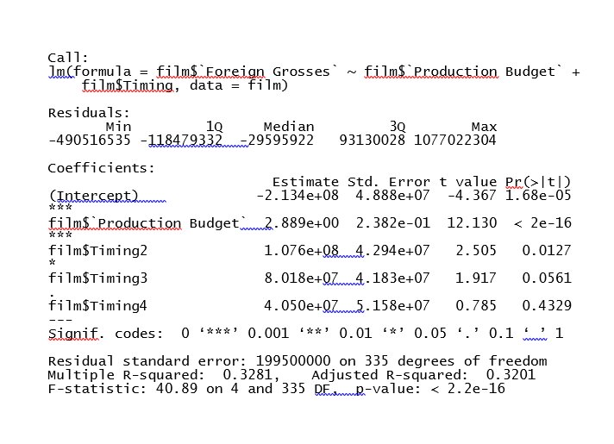
Multiple Linear Regression #2

